Slide 1
Exact solution of a Levy walk model for anomalous heat transport
Keiji Saito （Keio University)
Abhishek Dhar (RRI)
Bernard Derrida (ENS)
Dhar, KS, Derrida, arXhiv:1207.1184

Slide 2
Recent important questions in heat-related problems
I. How can we control heat ?
♦ Rectification ( Thermal diode, Thermal transistor )
♦ Thermoelectric phenomena
Design of material with high figure of merit ZT
II. What is general characteristics of heat conduction in
low-dimensions ?
in low-dimensions, how similar and dissimilar is heat conduction to electric one

Slide 3



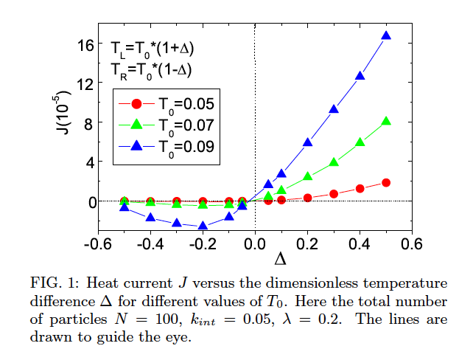
I. How can we control heat ?
Example of rectification ( Thermal diode )
Two different sets of parameters

Slide 4
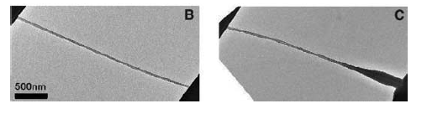
◆ Experiment: Carbon-Nanotube
chang etal.,science (2006)
J
L
J
R

Slide 5
Recent important questions in heat-related problems
I. How can we control heat ?
♦ Rectification ( Thermal diode, Thermal transistor )
♦ Thermoelectric phenomena
Design of material with high figure of merit ZT
II. What is general characteristics of heat conduction in
low-dimensions ?
T
in low-dimensions, how similar and dissimilar is heat conduction to electric one
Today’s main topic

Slide 6
Many similarities
Electric conduction vs. Heat conduction
Ohm’s law Fourier’s law
Ballistic transport Ballistic heat transport
Quantum of conductance Quantum of thermal cond.
Diode Thermal diode
••
••
in low-dimensions, how similar and dissimilar is heat conduction to electric one

Slide 7
Content
Classification of heat transport
Phenomenological model: Levy walk model

Slide 8

Fourier’s law
♦ Heat flows in proportional to temperature gradient
♦ Heat diffuses following diffusion equation（Normal diffusion)
→ Linear temperature profile at steady state
♦ Thermal conductivity is an intensive variable

Slide 9
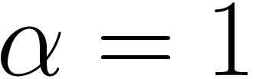
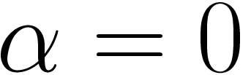
Classification of transport
Definition of thermal conductivity
Ballistic transport
Fourier’s law
Anomalous transport

Slide 10
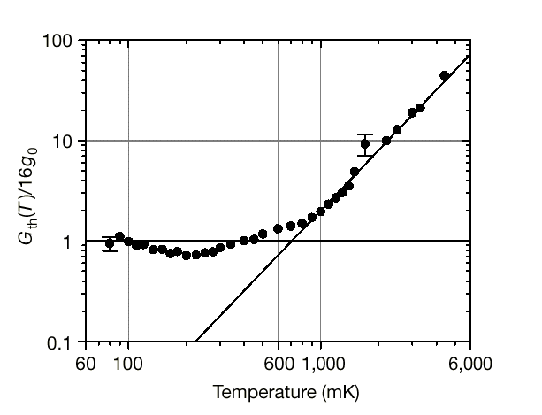
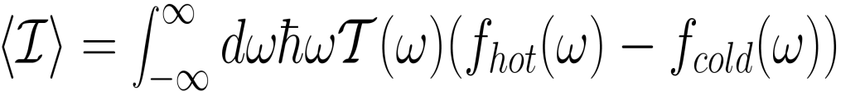
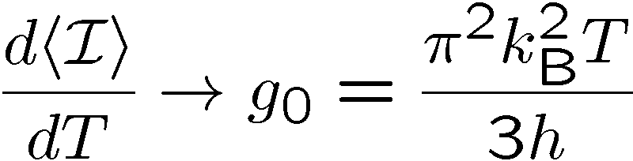
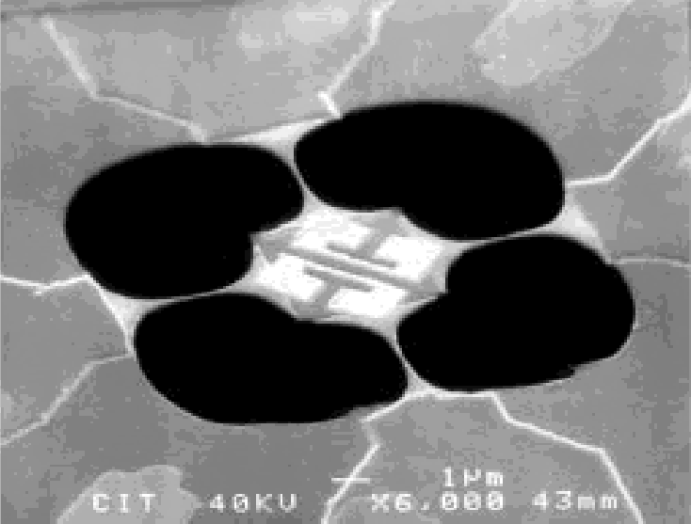
Harmonic chain
Rieder, Lebowitz, and Lieb (1967)
♦ Linear divegence of conductivity： Ballistic transport
♦ Quantum of thermal conductance at low temperatures
hot
cold
K.Schwab et al, Nature (2000)

Slide 11


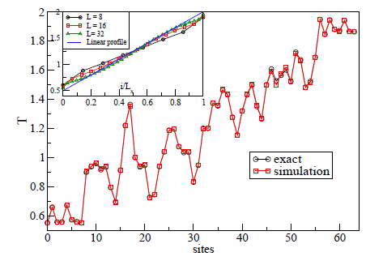
Disorder effect in 1D
-Localization-
Matsuda, Ishii (1972)
1. Finite temperature gradient
２. Vanishing conductivity ： Localization

Slide 12
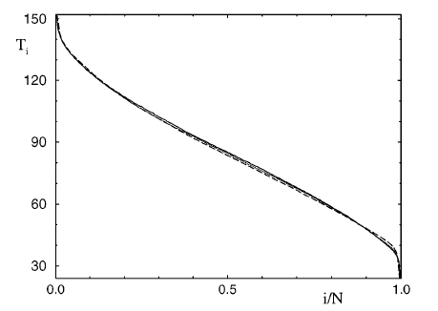
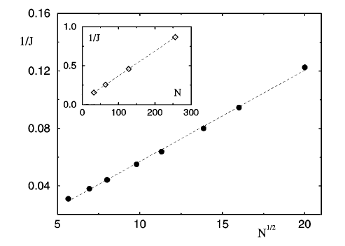
Nonlinear chain: Fermi-Pasta-Ulam (FPU) model
Lepri et al. PRL (1997)
1. Finite temperature gradient, but nonlinear curve
２. Diverging conductivity ： Anomalous transport

Slide 13
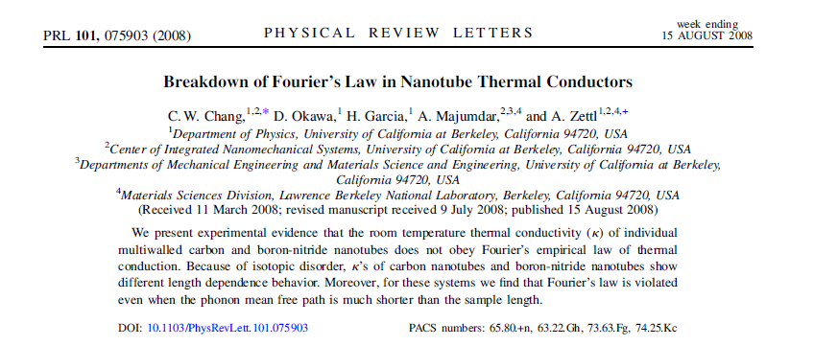
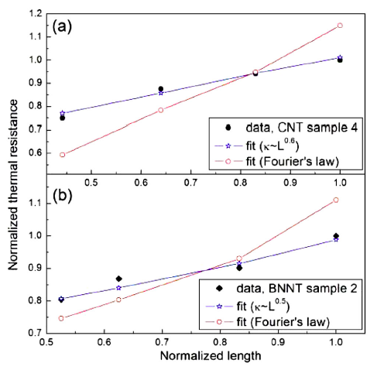
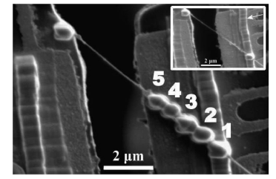
Anomalous transport reported in carbon-nanotube

Slide 14
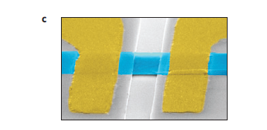
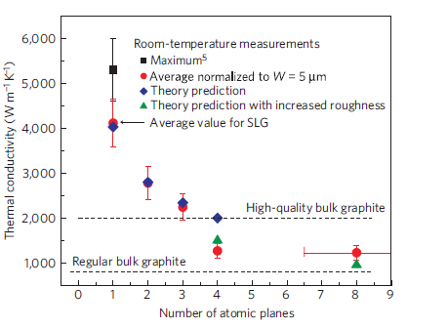
Crossover from 2D to 3D is very fast
: Graphene experiments
Ghosh et al., Nature Materials (2010)
Few-Layer Graphene

Slide 15
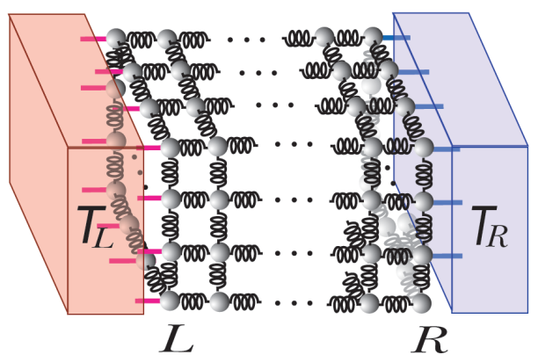

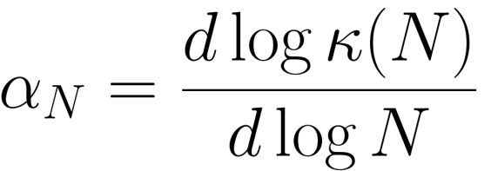
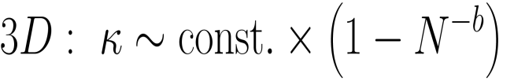

In 3D, Fourier’s law is universal
KS, Dhar PRL (2010)
♦ ３D FPU lattice
Inset:

Slide 16
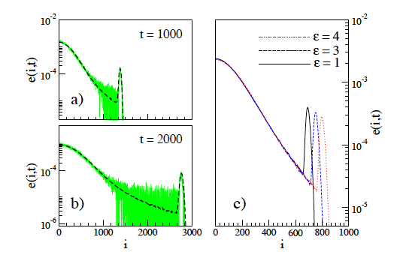
Anomalous heat diffusion in FPU chain
♦Diffusion of heat in FPU model without reservoirs
• • •
• • •
V. Zaburdaev, S. Denisov, and P. Hanggi PRL (2011)
Formation of hump in addition to Gaussian wave packet

Slide 17
Diffusion described by
Levy walk reproduces anomalous heat diffusion
: time of flight
← probability
♦
Super-diffusion

Slide 18
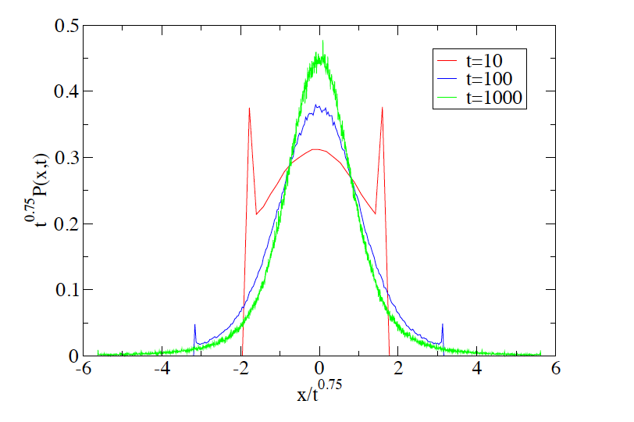
Demonstration of Levy walk diffusion

Slide 19
Heat transport is universally anomalous in low-dimensions
♦ Important properties
１： Divergent conductivity
２： Temperature profile is nonlinear
３： Anomalous diffusion

Slide 20
Anomalous heat transport versus Levy walk model
Anomalous transport
１： Divergent conductivity
２： Temperature profile is nonlinear
３： Normal diffusion equation is not valid
(since Fourier’s law is not valid)
Question
Can we reproduce the above properties by Levy walk model ?
2. What is the equation corresponding to Fourier’s law ?
3. Current fluctuation ?

Slide 21
Levy walk model with particle reservoirs
♦ Dynamics
: Probability that a walker changes direction after time τ
: Density that particles changes direction at the position x at time t
♦ Boundary condition
♦ Particle density at time t and the position x

Slide 22
Exact solutions
♦ Density profile (Temperature profile in heat conduction language)
♦ Size-dependence of current
♦ Current fluctuation in a ring geometry and modification of Levy walk

Slide 23
Density profile at steady state
♦ density (temperature) profile
♦ Levy walk model vs. FPU chain
Levy walk model
FPU chain

Slide 24
Size dependence of current
♦ Size-dependence of current -reproduce anomalous transport-
♦ Microscopic diffusion vs. anomalous conductance

Slide 25
Equation corresponding to Fourier’s law
Cf. Fourier’s law
♦ Nonlocal relation between current and temperature gradient

Slide 26
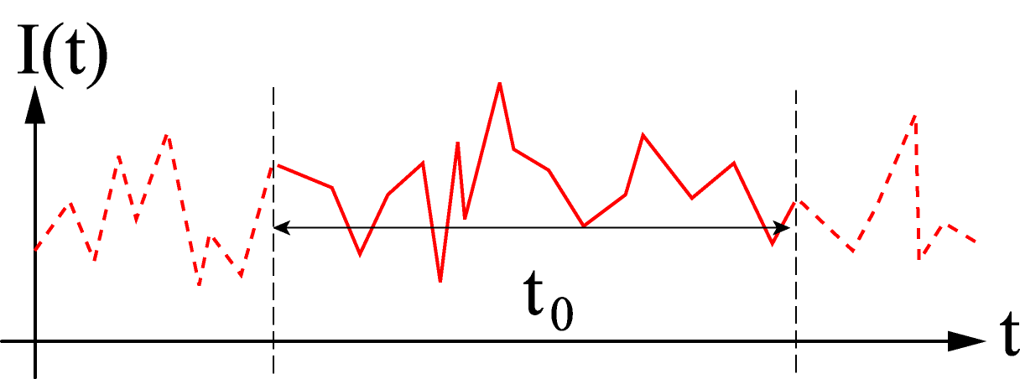

Current fluctuation in the open geometry

Slide 27
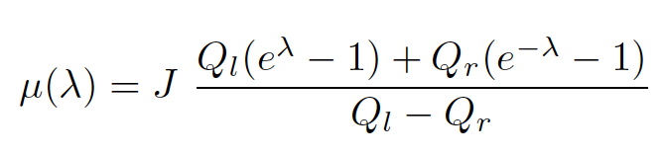
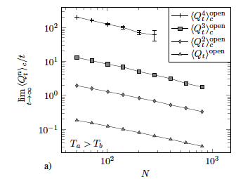
♦ Cumulant generating function for Levy-walk model
♦ This tells us that all order cumulants have the same exponent in size-dependence. This is consistent with numerical observation for specific model
E. Brunet, B. Derrida, A. Gerschenfeld, EPL (2010)

Slide 28
Summary
♦ We introduced Levy-walk model to explain anomalous heat transport
Exact density profile
size-dependence of current
relation corresponding to Fourier’s law (nonlocal)
♦ All current fluctuation have the same system-size dependence.
Levy-walk model is a good model for describing anomalous transport

Slide 29

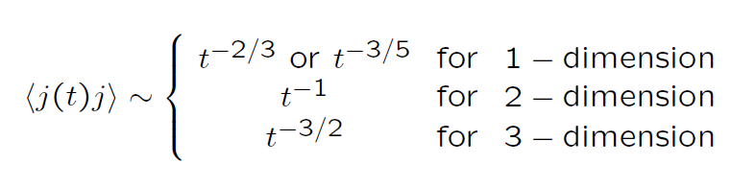
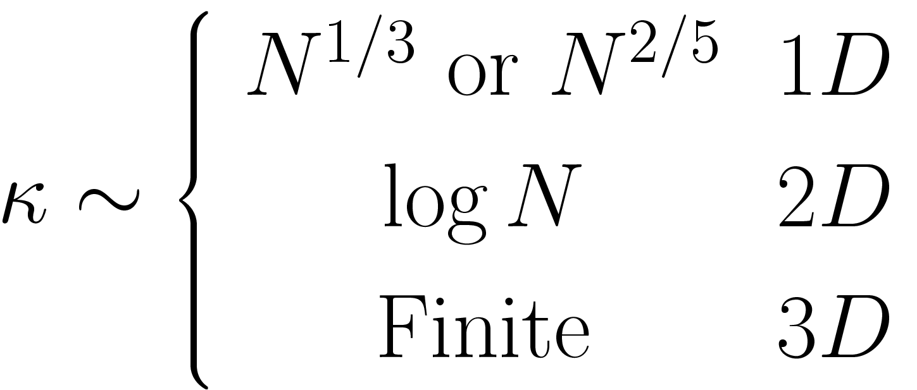
Anomalous heat conductivity
♦ Green-Kubo Formula
Renormalization Group theory, mode-coupling theory, etc…
(Lepri , etal.,EPL (1999), Narayan, Ramaswamy prl 2004)
3-dimension => Fourier’s law

Slide 30
Disorder effect in 1D
Localization
Matsuda, Ishii (1972)
1. Finite temperature gradient
２. Vanishing conductivity ： Localization

Slide 31
Realization of each class of transport
♦ Uniform harmonic chain
♦ High-dimension 3D
with nonlinearity
♦ Nonlinear effect in 1D and 2D
(Fermi-Pasta-Ulam model）
Ballistic Transport
Fourier’s law
Anomalous Transport

Slide 32
Calculation at the steady state
♦ Original dynamics
♦ no time-dependence at steady state
♦ simple manipulations yields an integral equation

Slide 33
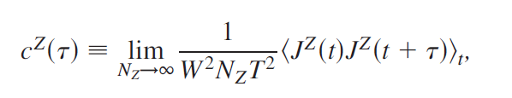
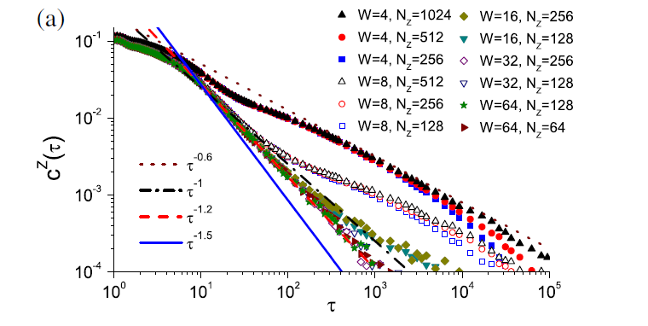

Calculation with Green-Kubo Formula
Lei Wang et al. PRL , vol. 105, 160601 (2010)
W
W
N_z

Slide 34
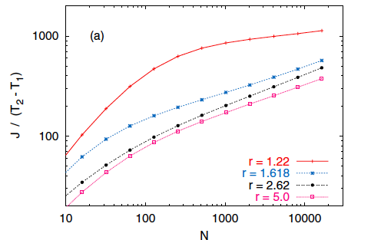
Another toy model showing anomalous transport
♦ Hardpoint gas
numerically easy to calculate
Large scale of computation is possible
mass ratio of and
Grassberger, Nadler, Yang, PRL (2002)
♦ is believed to be valid at least in this model

Slide 35
Remark: Why levy walk ? not Cattaneo equation
♦ Cattaneo equation can form front in the time-evolution of wave packet
Mixture of ballistic and diffusive evolution
♦ But Cattaneo yields linear temperature profile at steady state,
FPU has nonlinear curve
FPU
Cattaneo
→ Cattaneo cannot describe anomalous diffusion

Slide 36
Again, our calculation
Inset:
Our result is consistent with recent
Green-Kubo Calculation

Slide 37

1．Width（W）-dependence in Heat Current
W
W
N
r → 0 for N →∞ !
Small W is enough
for 3D.

Slide 38
Content
Topic １. Exact solution of a Levy walk model
for anomalous heat transport
Topic ２. Current fluctuation in high-dimensions
Dhar, KS, Derrida, arXhiv:1207.1184
KS, A. Dhar, Phys. Rev. Lett. vol.107, 250601 (2011)

