Slide 1
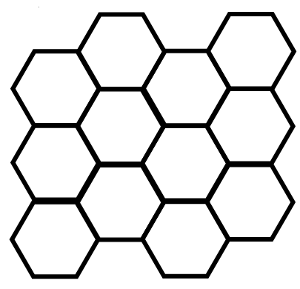
QUANTUM CHAOS IN GRAPHENE
Spiros Evangelou
is it the same as for any other 2D lattice?

Slide 2
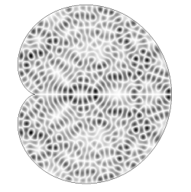
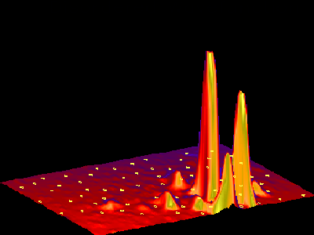
DISORDER: diffusive to localized
  TOPOLOGY: integrable to chaotic
|ψ|
quantum interference of classically chaotic systems
|ψ|
quantum interference of electron waves in a random medium

Slide 3
energy level-statistics
quantum chaos (averages over energy E)
Anderson localization (averages over disorder W)
random matrix theory!

Slide 4


P(S) level-spacing distribution
Poisson
$$P\left(S\right)=exp⁡(−S)$$
to
Wigner
$$P\left(S\right)=A Sexp⁡(−BS^{2})$$
integrable to chaotic
localized to diffusive
at the transition?

Slide 5
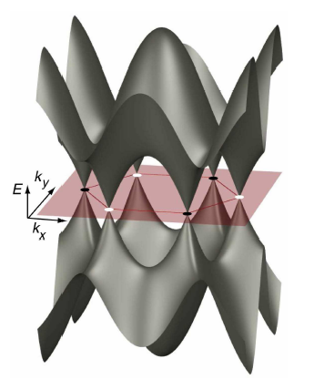
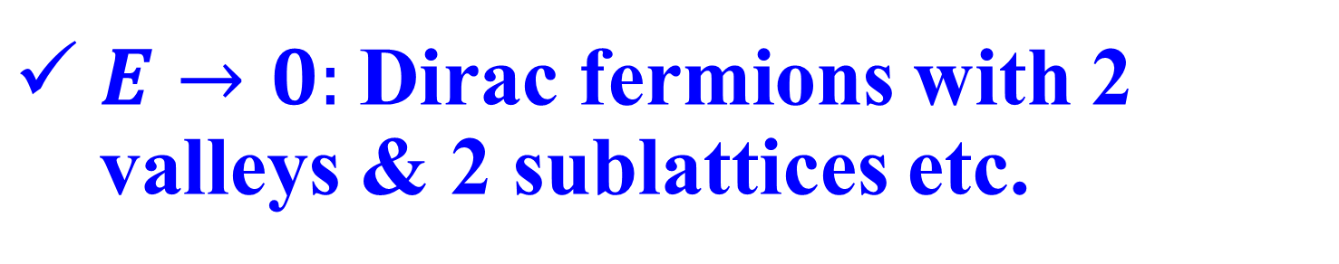
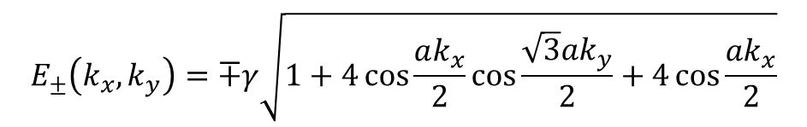
graphene
a sheet of carbon atoms on a hexagonal lattice
$E→0:$Dirac fermions with 2 valleys & 2 sublattices etc.
$$E_{±}\left(k_{x},k_{y}\right)=∓γ\sqrt{1+4\cos{\frac{ak_{x}}{2}}\cos{\frac{\sqrt{3}ak_{y}}{2}}+4\cos{\frac{ak_{x}}{2}}}$$

Slide 6
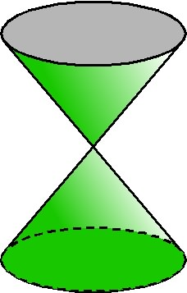
DOS
Dirac cones near E=0
E
two bands touch at the Dirac point E=0
linear small-k dispersion near Dirac point
electrons with large velocity and zero mass
fundamental physics & device applications
6

Slide 7
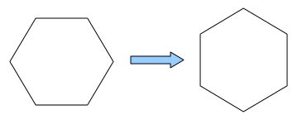
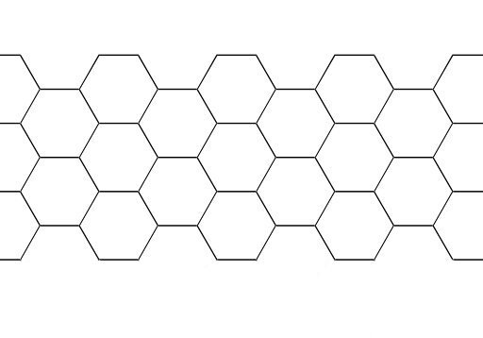
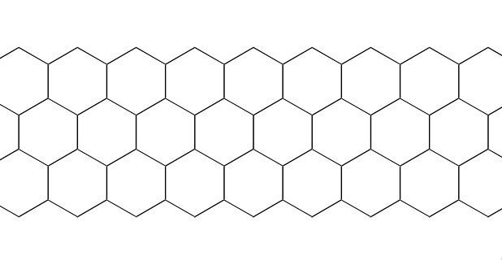
…edge states in graphene
chirality
armchair and zigzag edges
nanoribbons
flakes:

Slide 8
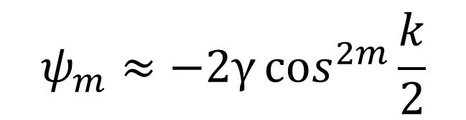



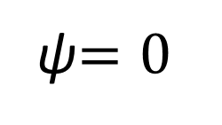
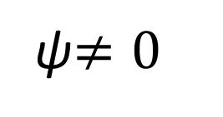








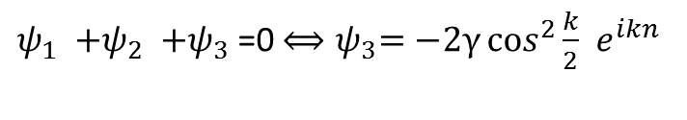
destructive interference
for zigzag edges
$$m=0$$
A atoms
ψ$=0$
$$…$$
ψ$≠0$
B atoms
$$m=1$$
$$ψ_{1 }$$
$$ψ_{2 }$$
${ψ_{1 }{+ψ}_{2 }+ψ}_{3 }$=0 ${⟺ψ}_{3}=−2γ\cos^{2}{\frac{k}{2}}{ e}^{ikn}$
$$m=2$$
$$ψ_{m}≈−2γ\cos^{2m}{\frac{k}{2}}$$
$$ψ_{3 }$$
$$…$$
$$k=π:$$
$$Nakada et al PRB 54,17954, 1996$$
$$ψ_{m}≠0 only for m=0$$
$$Wakabayashi et al PRB 54, 8271, 1999$$
edge states

Slide 9
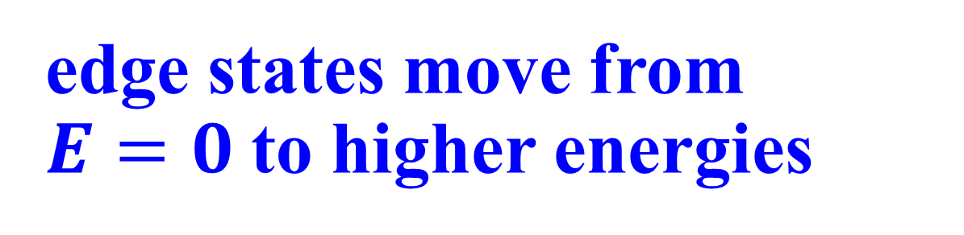
in the presence of disorder
(ripples, rings, defects,…)
diagonal disorder (breaks chiral symmetry)
off-diagonal disorder (preserves chiral symmetry)
edge states move from $E=0$to higher energies
what is the level-statistics of the edge states close to DP?

Slide 10
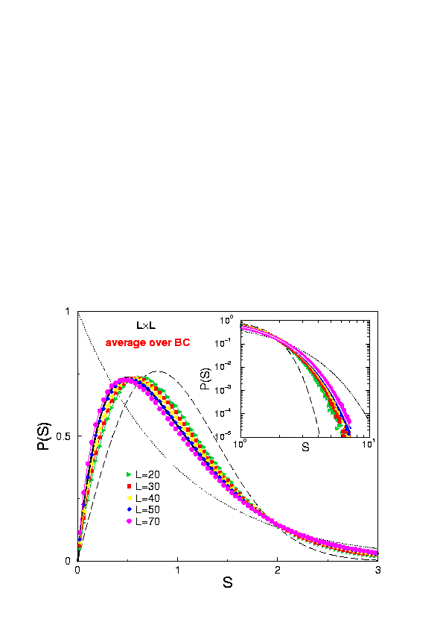
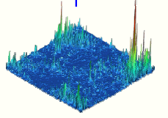


3D localization
Poisson
Wigner
$$P\left(S\right)=exp⁡(−S)$$
$$P\left(S\right)=A Sexp⁡(−BS^{2})$$
intermediate statistics?

Slide 11
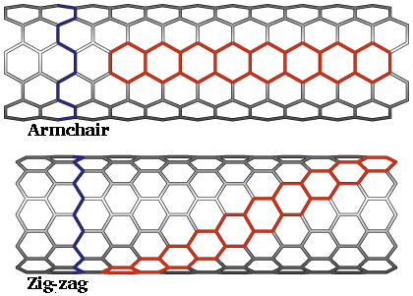
L
disordered nanotubes
W
energy level-statistics
participation ratios
spacing
energy
Amanatidis & Evangelou PRB 2009

Slide 12
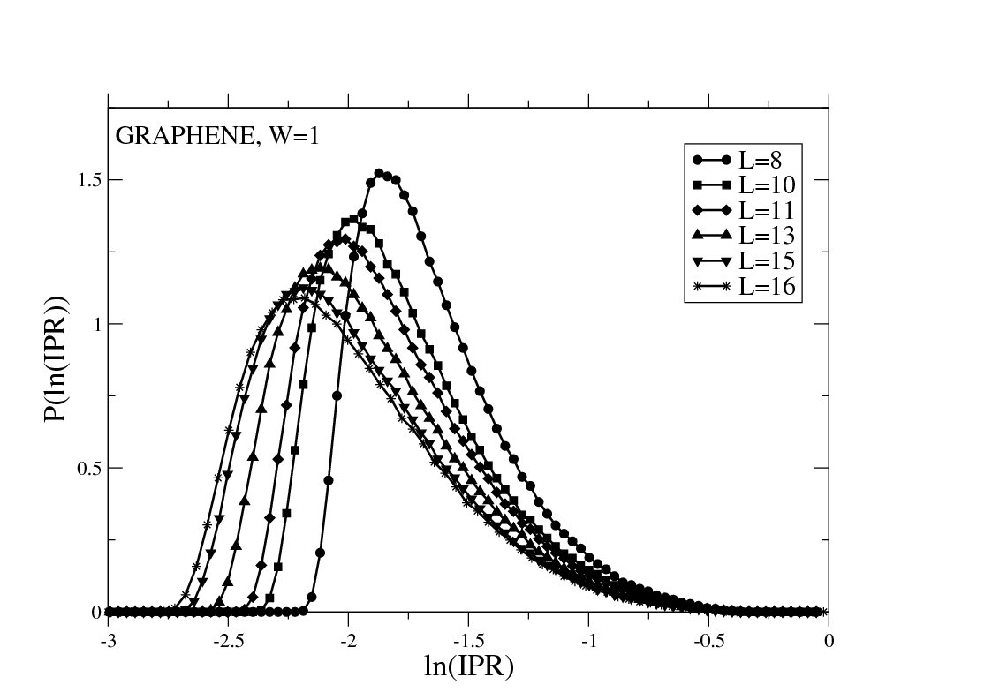
the E=0 state
participation ratio:
distribution of PR

Slide 13
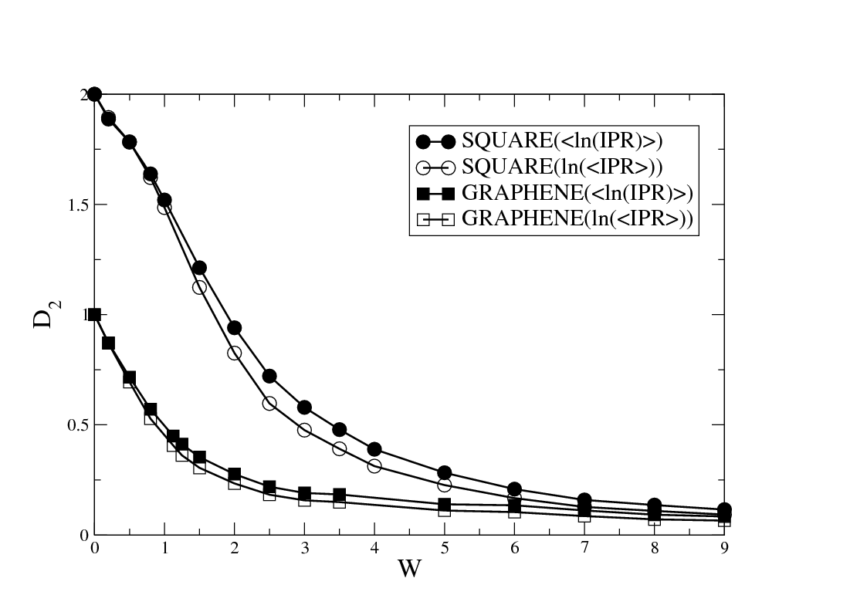
fractal dimension
From PR(E=0) vs L
Kleftogiannis and Evangelou (to be published)

Slide 14
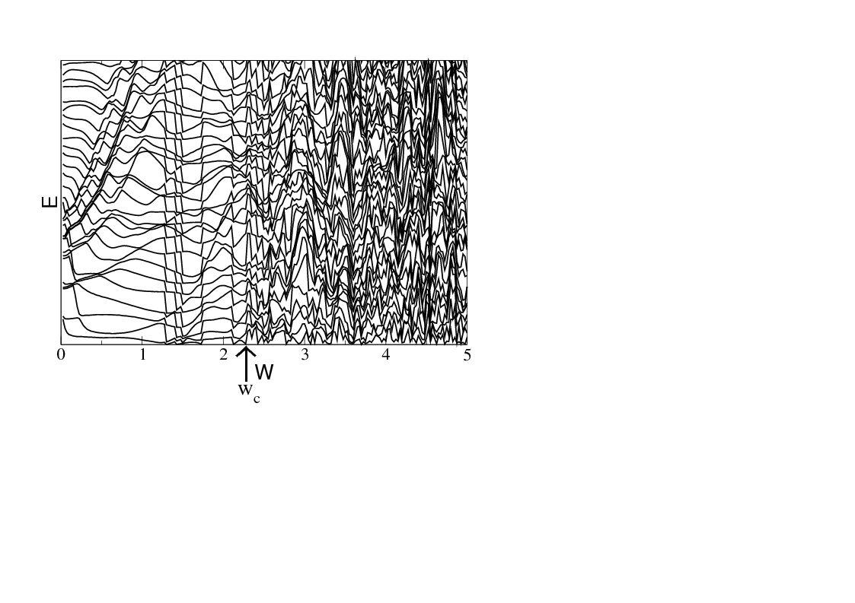
level-statistics
from semi-Poisson to Poisson

Slide 15
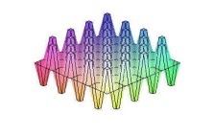
is graphene the same as any 2D lattice?
zero disorder: ballistic motion (Poisson stat)
weak disorder: fractal states & weak chaos
(semi-Poisson statistics)
strong disorder: localization & integrability
(Poisson statistics)
graphene lies between a metal and an insulator!
Amanatidis et al (to be published)

