Slide 1
NANO-CTM Meeting
Cargese, 25 October 2012
Tunneling between helical edge states through extended contacts
Giacomo Dolcetto
Università degli Studi di Genova, Physics Department

Slide 2
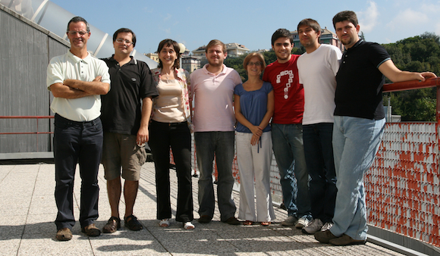
In collaboration with …
Quantum transport and nanodevices
Nicodemo Magnoli, Maura Sassetti, Dario Ferraro and Simone Barbarino

Slide 3
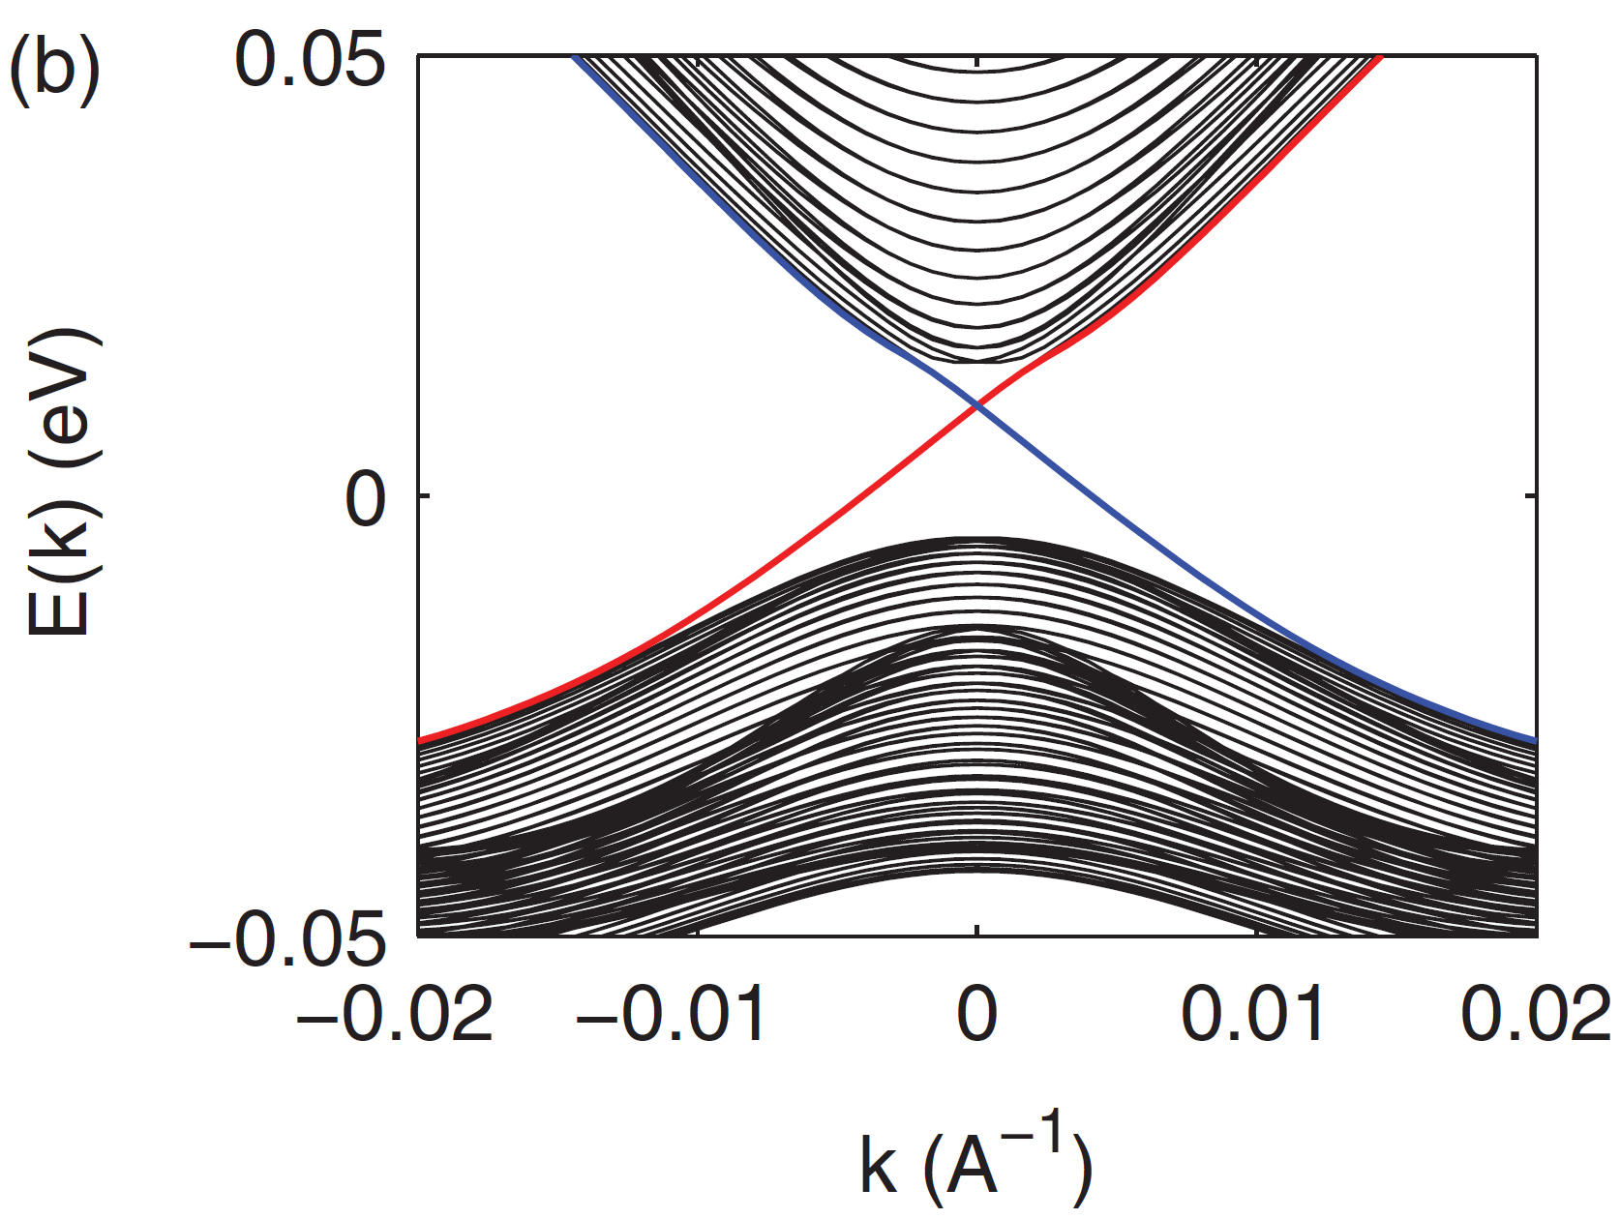
Outline
CdTe
Two-dimensional topological insulators
HgTe
CdTe
Helical edge states
Tunneling in QPC geometry
Tunneling through extended contacts

Slide 4
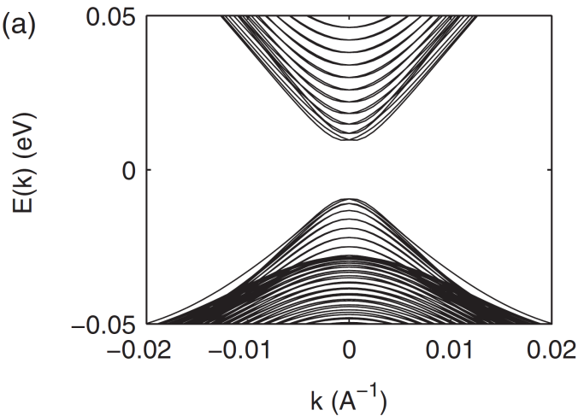
Two-dimensional topological insulators
[B. A. Bernevig, T. L. Hughes, and S.-C. Zhang, Science 314, 1757 (2006)]
CdTe
HgTe
CdTe
CdTe
HgTe
CdTe
Insulating bulk states VS conducting edge states
Spin and momentum are locked into each other
[L. Qi and S.-C. Zhang, Rev. Mod. Phys. 83, 1057 (2011)]

Slide 5
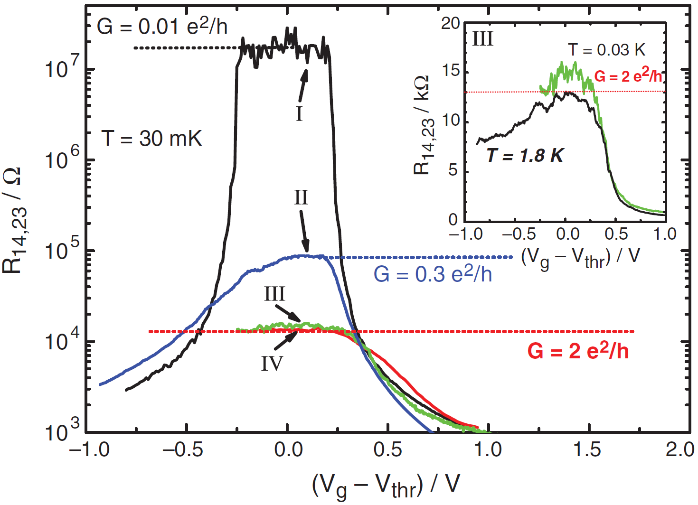
Quantum spin Hall effect
[C. L. Kane and E. J. Mele, Phys. Rev. Lett. 95, 146802 (2005)]
[M. König et al., Science 318, 766 (2007)]

Slide 6
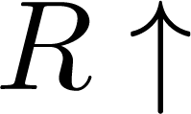
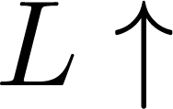
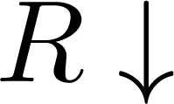
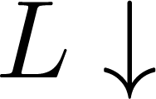
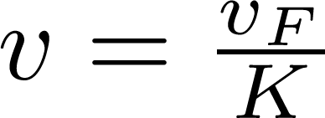
Helical Luttinger liquid
[C. Wu, B. A. Bernevig, S. –C. Zhang, PRL 96, 106401 (2006)]
Quantum wire
QHE
QSHE
Spinfull LL
Chiral LL
Helical LL
Bosonization:
Unique collective excitations propagation velocity

Slide 7
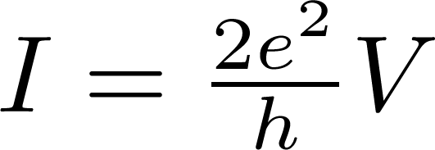
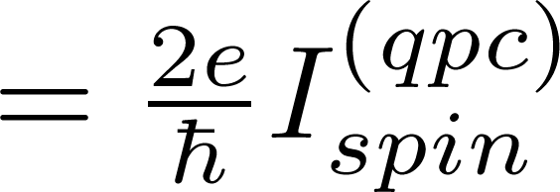
Tunneling through QPC
[A. Strom, H. Johannesson, PRL 102, 096806 (2009)]
Interaction-dependendent power-laws

Slide 8
Tunneling through extended contacts
[G. D., S. Barbarino, D. Ferraro, N. Magnoli, M. Sassetti, PRB 95, 195138 (2012)]
The modulating function depends on bias and temperature, thus modifying QPC behaviours

Slide 9
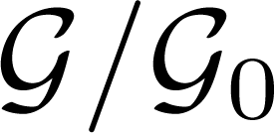
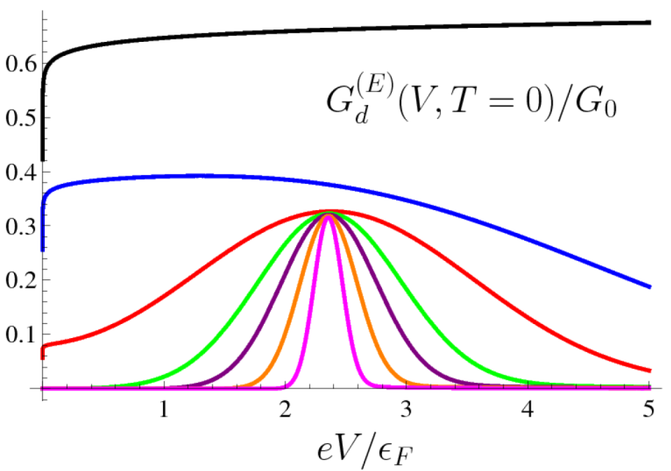
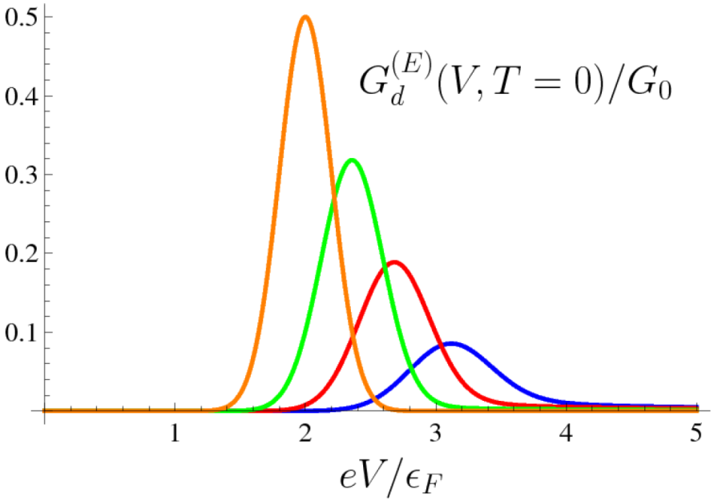
Tunneling through extended contacts
[G. D., S. Barbarino, D. Ferraro, N. Magnoli, M. Sassetti, PRB 95, 195138 (2012)]
Tunneling conductance shows a unique peak for an interaction dependent bias voltage value
Information about interaction strength
Measurament of the peak
no spin-charge separation in helical LL but close connection between spin and momentum
Unique peak

Slide 10
Summary
Helical edge states in QSHE are carachterized by close connection between spin and chirality
Tunneling properties are useful in order to study the properties of the helical edge states
Extended tunneling contacts may confirm the helicity of the edge states, and allow to extract informations about interactions
Thank you for your attention!

Slide 11
NANO-CTM Meeting
Cargese, 25 October 2012
Tunneling between helical edge states through extended contacts
Giacomo Dolcetto
Università degli Studi di Genova, Physics Department

Slide 12
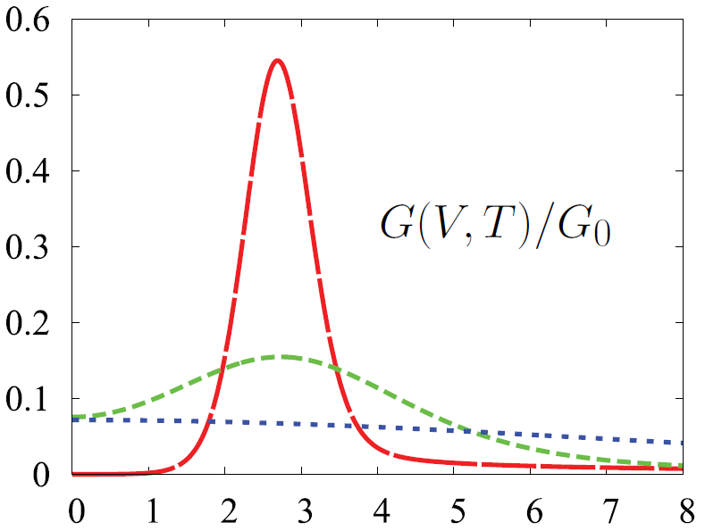
Finite temperature effects

Slide 13
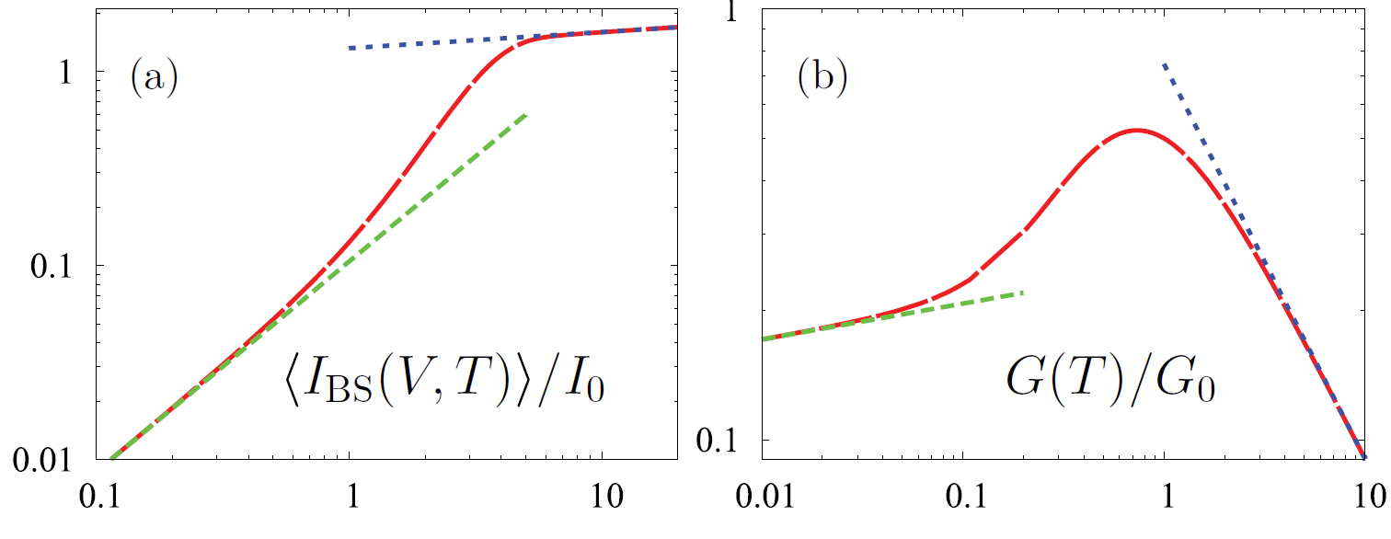
New power-laws behaviors

Slide 14
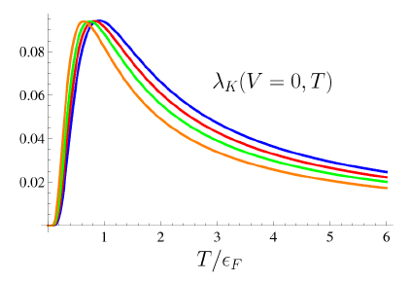
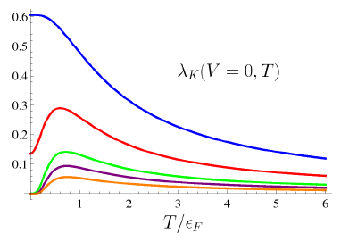
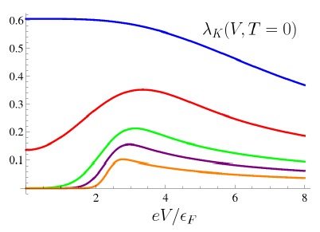
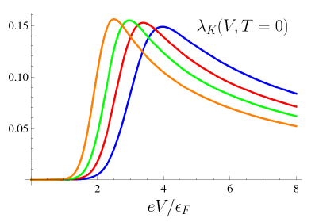
Other useful plots…
Varying the length of the contact
Varying the interaction
Varying the length of the contact
Varying the interaction

Slide 15
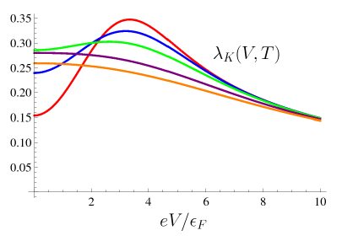
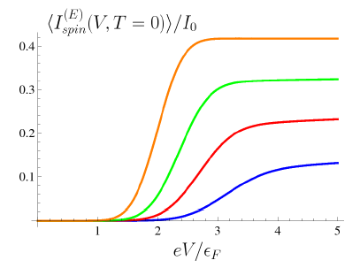
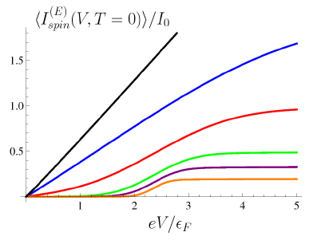
Other useful plots…
Varying the temperature
Varying the interaction
Varying the length of the contact

Slide 16
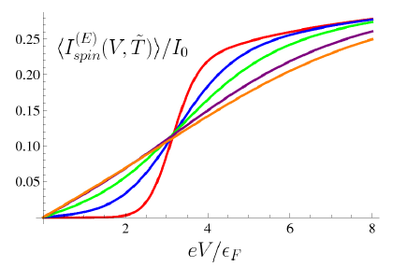
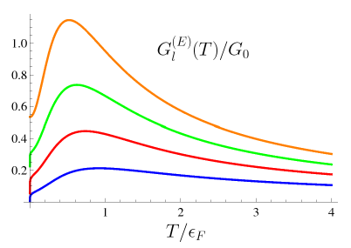
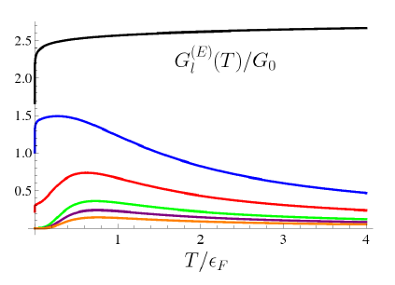
Other useful plots…
Varying the temperature
Varying the interaction
Varying the length of the contact

Slide 17
