Slide 1
LIDYL/LFP Reaction Dynamics Endstation
Time-resolved relaxation dynamics
of isolated species
Guillaume Gallician, Anja Röder, Malay Dalui, Barbara Cunha de Miranda,
Jean-Michel Mestdagh, Lionel Poisson
LIDYL, CEA, CNRS, Université Paris-Saclay, CEA Saclay 91191 Gif-sur-Yvette France.
ATTOLab Users Meeting 2019, November 27th 2019

Slide 2
Scientific Case
Time resolved relaxation dynamics of isolated compounds
Ground State
Ion
Excited State
Probe by ionization
- Cross section efficiency
- PhotoElectron energy
Ground State
neutral
Photorelaxation process
Energy Transfert
ATTOLab Users Meeting 2019, November 27th 2019

Slide 3
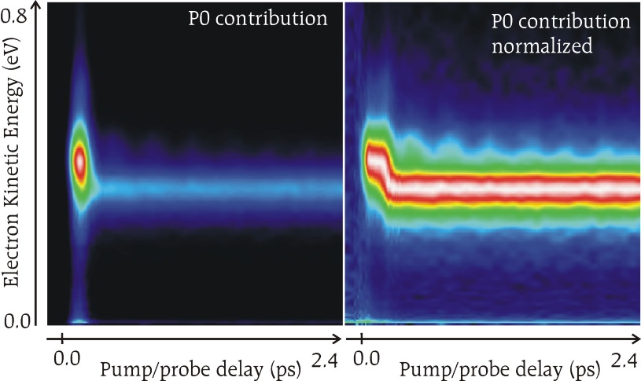
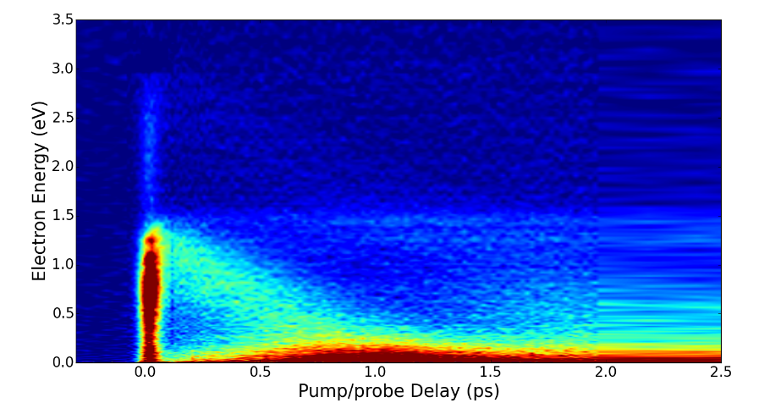
Exemples
Relaxation dynamics of photochromic molecules
Vibronic relaxation
+ Talk from Pr. Ingo Fischer
Solvation dynamics
Relaxation dynamics of clusters
Phys. Chem. Chem. Phys. 2018, 20, 11206. Phys. Chem. Chem. Phys. 2014, 16, 516.
Phys. Chem. Chem. Phys. 2014, 16, 22262. J. Phys. Chem. A 2010, 114, 3313.
ATTOLab Users Meeting 2019, November 27th 2019

Slide 4
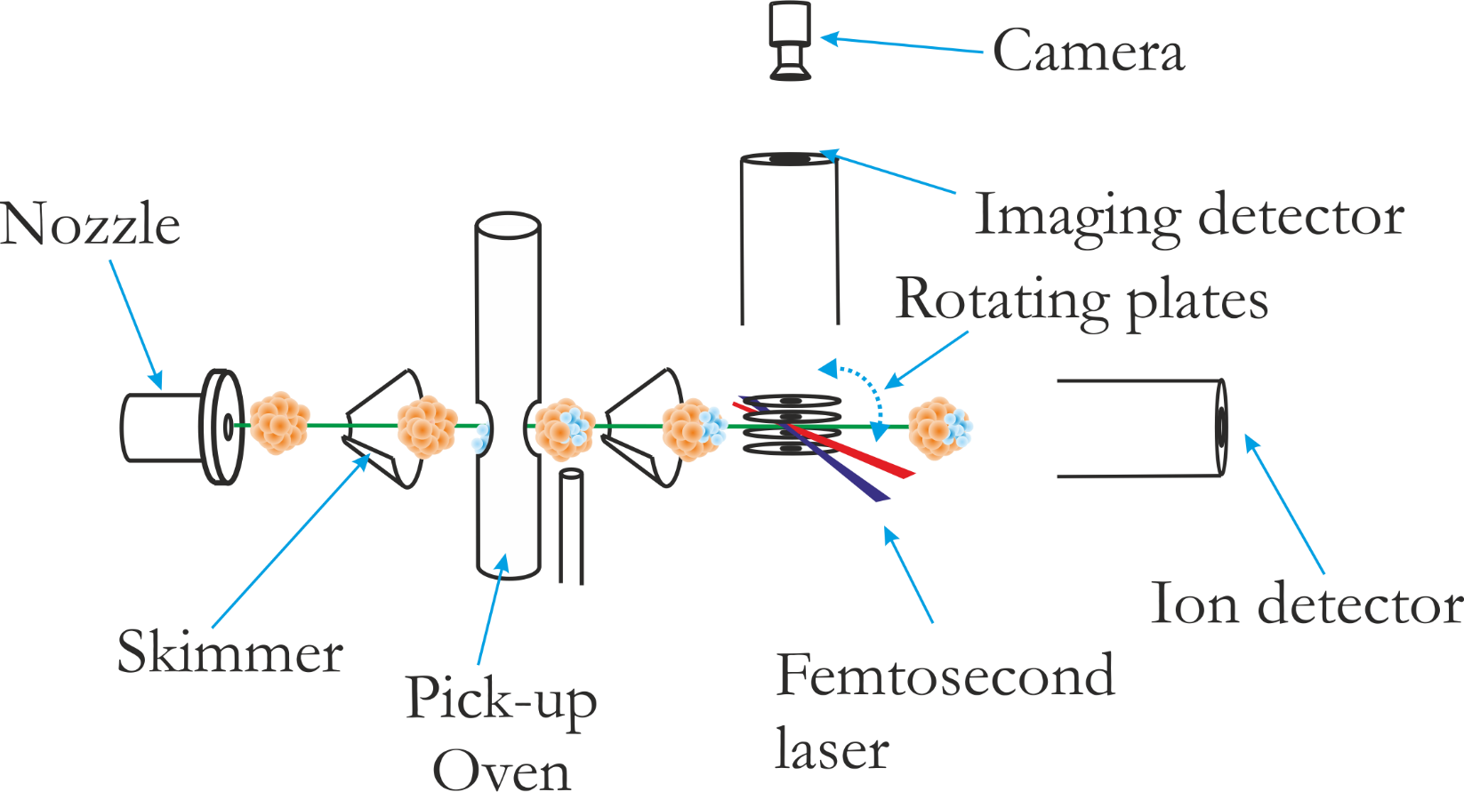
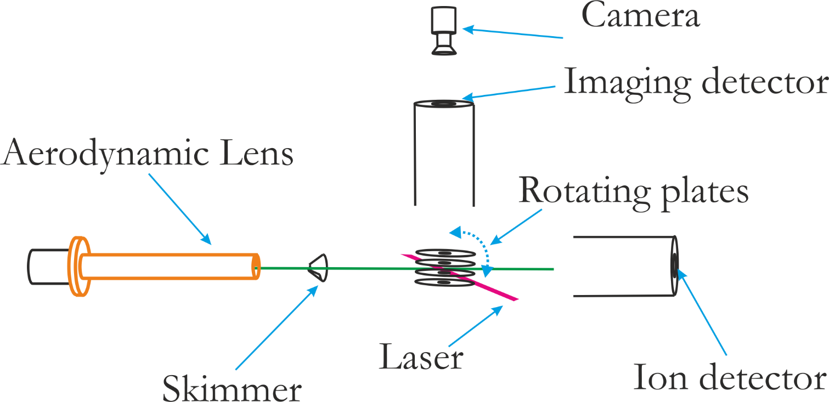
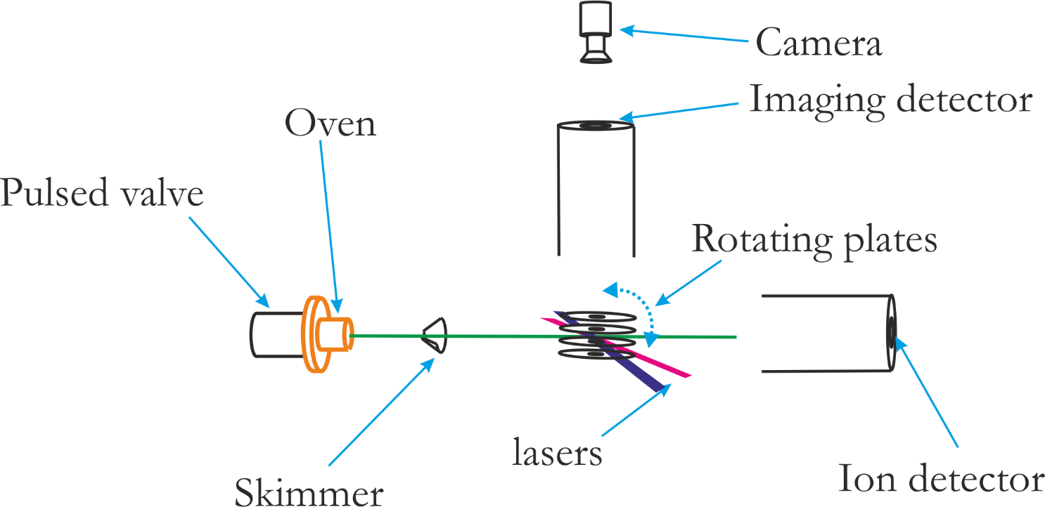
Upgrade of the Endstation
Upgrade of mirors (2’’)
Upgrade of the detection chain (sensitivity and repetition rate)
Upgrade of the source (repetition rate)
Upgrade to the ATTOLab standard of the pumping system & cleaning
ATTOLab Users Meeting 2019, November 27th 2019

Slide 5
Possible Experiments
Improved repetition rate
Low density molecular beam
Isolated Nanoparticles
Clusters
Larger number of parameters to tune
+ Stability
Better Signal/Noise
Wavepacket motions
+ Pulse duration
Ionization dynamics
+ Wavelenght tunability
Larger panel of molecular systems
Wavelenght dependant reactivity
Lower Valence Ionization with HHG
ATTOLab Users Meeting 2019, November 27th 2019

Slide 6
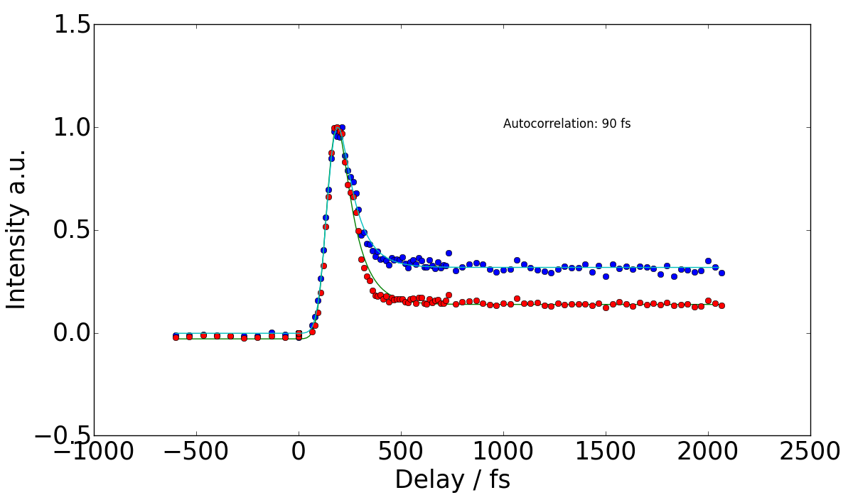
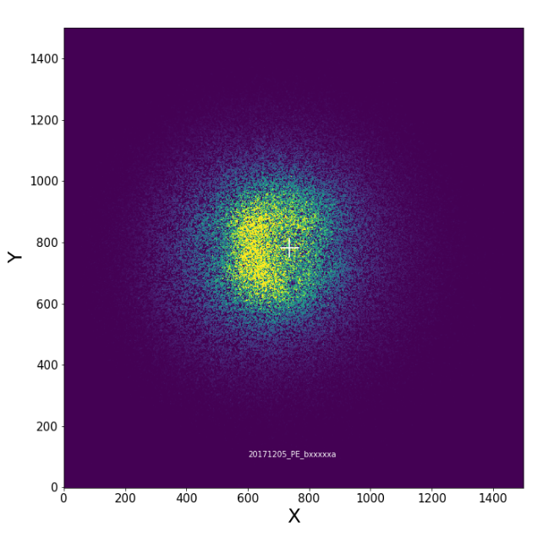
Commissioning
Pump/probe experiment
Nanoparticle Photoionization (nanofocusing)
First LASERLAB run with the group of Pr. Ingo Fischer
ATTOLab Users Meeting 2019, November 27th 2019

